Slide 1
RESEARCH METHODOLOGY AND INTELLECTUAL PROPERTY RIGHTS Course Code: AL58

Slide 2
Course Outline
Unit I
Research Methodology
Introduction: Meaning of Research, Objectives of Research, Types of Research, Ethics in Research, Types of Research Misconduct.
Literature Review and Technical Reading: New and Existing Knowledge, Analysis and Synthesis of Prior Art, Bibliographic Databases, Conceptualizing Research, Critical and Creative Reading.
Citations: Functions and Attributes, Impact of Title and Keywords on Citations, Knowledge flow through Citations, Acknowledgments, and Attributions.

Slide 3
Unit II
Research Design: Need for Research Design, Important Concepts Related to Research Design: Dependent and Independent Variables, Extraneous Variable, Variable, Common Control, Confounded Relationship, Research Hypothesis, Experimental and Control Groups, Treatments.
Experimental Designs: Introduction to Randomised Block Design, Complete Randomised Design, Latin Square Design, and Factorial Design.

Slide 4
Unit III
Method of Data Collection: Primary and Secondary Data Collection.
Sampling Design: Sampling fundamentals, Measurement, and Scaling Techniques, Criteria of Selecting a Sampling Procedure, Characteristics of a Good Sample Design, and Types of Sample Design.
Data Analysis: Testing of Hypotheses: Null Hypothesis, Alternative Hypothesis, Type I and Type II Errors, Level of Significance. Procedure for Hypothesis Testing: Mean, Variance, Proportions. Chi-square Test, Analysis of Variance (One Way ANOVA), and Covariance (ANOCOVA)

Slide 5
Unit IV
Intellectual Property Rights
Introduction to IPR: Different forms of IPR, Role of IPR in Research and Development. TRIPS Agreement, Patent Cooperation Treaty (PCT).
Patents: Brief history of Patents-Indian and Global Scenario, Principles Underlying Patent Law, Types of Patent Applications in India, Procedure for Obtaining a Patent. Non Patentable Inventions. Rights Conferred to a Patentee, Basmati Rice Patent Case.

Slide 6
Unit V
Design: What is a Design? Essential Requirements for a Registrable Design, Procedure of Registration of a Design,
Trademarks: Essentials of a Trademark, Registration, and Protection of Trademarks, Rights Conferred by Registration of Trademarks, Infringements, Types of Reliefs, Case Studies.
Copyrights: Characteristics of Copyrights, Rights Conferred by Registration of Copyrights, Registration of Copyrights, Infringements, Remedies against Infringement of Copyrights, Case studies

Slide 7
Textbooks
C. R Kothari, Gourav Garg, Research Methodology – Methods and Techniques. New Age International Publishers.
Dr. B L Wadehra – Law relating to Intellectual property. Universal Law Publishing Co.
Dipankar Deb, Rajeeb Dey, Valentina E. Balas “Engineering Research Methodology”, ISSN 1868-4394 ISSN 1868-4408 (electronic), Intelligent Systems Reference Library, ISBN 978-981-13-2946-3 ISBN 978-981-13-2947-0 (eBook), https://doi.org/10.1007/978-981-13-2947-0.

Slide 8
Reference Books
David V. Thiel “Research Methods for Engineers” Cambridge University Press, 978-1-107-03488-4

Slide 9
Course Outcomes
At the end of the course, the student will be able to:
Possess the knowledge of research and conduct a literature review.
Apply the knowledge of research design and design of experiments.
Analyze data collection methods, analysis, and sampling design.
Understand the global and Indian scenarios of patents and patent applications.
Acquire the requirements of registration and infringements related to trademarks, copyrights, and designs.

Slide 10
Course Assessment
CIE- 30 Marks
Quiz– 10 Marks
Numerical Test-10 Marks

Slide 11

“Science is not belief, but the will to find out.”

Slide 12
Research Methodology
AND
Intellectual property rights

Slide 13
Research Methodology
Composed of two syllables “Re” and “Search”.
“Re”=‘Again or over again or a new’ and
“Search”=is the latter meaning ‘to examine closely and carefully’ or ‘to test and try’

Slide 14
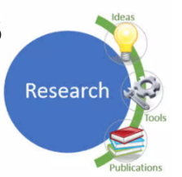
Meaning of Research
Search for knowledge
Scientific and systematic search for pertinent information on a specific topic
An art of scientific investigation
Systematized effort to gain new knowledge
A movement from the known to the unknown.
It is actually a voyage of discovery

Slide 15
research comprises
defining and redefining problems,
formulating hypothesis or suggested solutions;
collecting, organizing and evaluating data;
making deductions and reaching conclusions;
and at last carefully testing the conclusions to determine whether they fit the formulating hypothesis.

Slide 16
‘research’ refers
The systematic method consisting of enunciating the problem, formulating a hypothesis, collecting the facts or data, analyzing the facts and reaching certain conclusions either in the form of solutions(s) towards the concerned problem or in certain generalizations for some theoretical formulation.

Slide 17
OBJECTIVES OF RESEARCH
To gain familiarity with a phenomenon or to achieve new insights into it.
To portray accurately the characteristics of a particular individual, situation or a group.
To determine the frequency with which something occurs or with which it is associated with something else.
To test a hypothesis of a causal relationship between variables

Slide 18
MOTIVATION IN RESEARCH
Desire to get a research degree along with its consequential benefits;
Desire to face the challenge in solving the unsolved problems, i.e., concern over practical problems initiates research;
Desire to get intellectual joy of doing some creative work;
Desire to be of service to society;
Desire to get respectability.

Slide 19
TYPES OF RESEARCH
Descriptive vs. Analytical
Descriptive research includes surveys and fact- finding enquiries of different kinds.
In analytical research, the researcher has to use facts or information already available, and analyze these to make a critical evaluation of the material.
Applied vs. Fundamental
Applied (or action) research: aims at finding a solution for an immediate problem facing a society or an industrial/business organization,
Fundamental(to basic or pure) research : mainly concerned with generalizations and with the formulation of a theory.

Slide 20
TYPES OF RESEARCH
Quantitative vs. Qualitative:
Quantitative research is based on the measurement of quantity or amount.
Qualitative research, is concerned with qualitative phenomenon, i.e., phenomena relating to or involving quality or kind.
Conceptual vs. Empirical:
Conceptual research : related to some abstract idea(s) or theory.
Empirical research : It is data-based research, coming up with conclusions which are capable of being verified by observation or experiment. We can also call it as experimental type of research.

Slide 21
TYPES OF RESEARCH
Some Other Types of Research:
One-time research or longitudinal research. In the former case the research is confined to a single time-period, whereas in the latter case the research is carried on over several time-periods.
Field-setting research or laboratory research or simulation research, depending upon the environment in which it is to be carried out.
Clinical or diagnostic research. Such research follow case-study methods or in-depth approaches to reach the basic causal relations.
Conclusion-oriented and decision-oriented. While doing conclusion-oriented research, a researcher is free to pick up a problem, redesign the enquiry as he proceeds and is prepared to conceptualize as he wishes.

Slide 22
Ethics in Research
Provides guidelines for the responsible conduct of research.
Some ethical principles are
Honesty
Objectivity
Integrity
Carefulness
Openness
Respect for Intellectual Property
Confidentiality

Slide 23
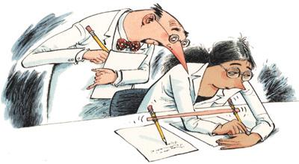
What are research misconducts?
Research Misconduct can be characterised as actions or questionable research practices that fall short of the standards of ethics, research and scholarship required to ensure that the integrity of research is upheld. It can cause harm to people and the environment, wastes resources, undermines the research record and damages the credibility of research.

Slide 24
TYPES OF RESEARCH Misconduct
Fabrication - making up data or results and recording or reporting them.(Reporting experiments, observations, or procedures that were never conducted.)
Falsification - manipulating research materials, or changing or omitting data or results such that the research is not accurately represented in the research record.(Changing values in a dataset to improve the appearance of results.)
Plagiarism - the appropriation of another person's ideas, processes, results, or words without giving appropriate credit.(Presenting someone else's work as one's own.
Example: Copying text from a published article without citation.
)

Slide 25
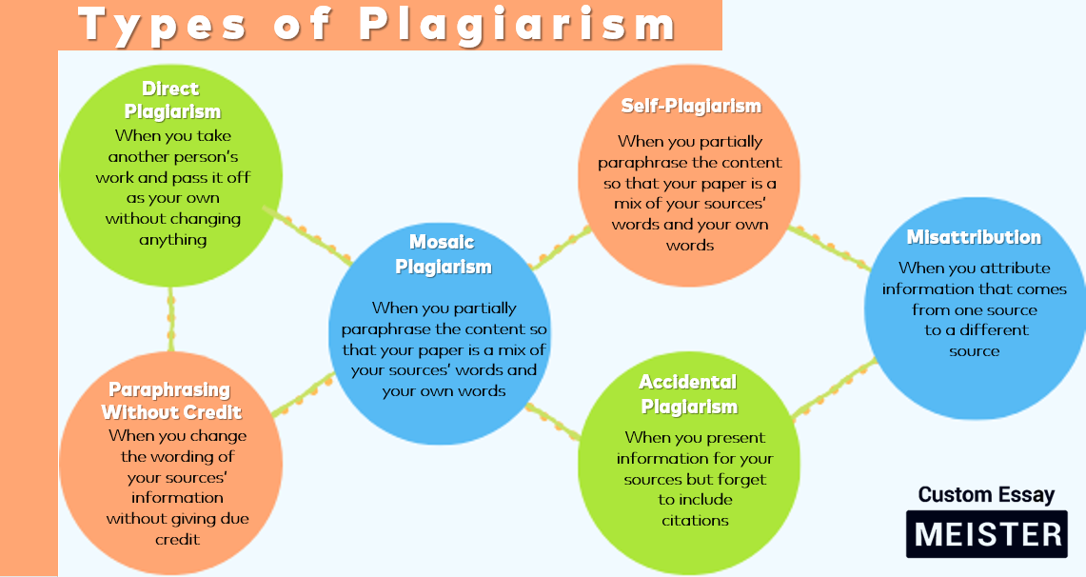
Types of Plagiarism
Example of Misattribution
Incorrect: “According to Smith (2020), water pollution is mainly caused by plastic waste.” (But this idea was actually from Johnson, 2019, not Smith.)

Slide 26
Literature Review and Technical Reading

Slide 27
New and Existing Knowledge
New knowledge in research can only be interpreted within the context of what is already known, and cannot exist without the foundation of existing knowledge.
One can infer that the knowledge that is sought to be produced does not yet exist by describing what other knowledge already exists and by pointing out that this part is missing so that what we have is original. To do this, one again needs the existing knowledge:
the context
the significance
the originality
the tools.

Slide 28
A literature review
A literature review should be able to summarize as to what is already known from the state of the art, detail the key concepts and the main factors or parameters and the underlying relationships between those, describe any complementary existing approaches, enumerate the inconsistencies or shortcomings in the published work, identify the reported results that are inconclusive or contradictory, and provide a compulsive reason to do further work in the field.
A good literature survey is typically a two-step process as enumerated below:
Identify the major topics or subtopics or concepts relevant to the subject under consideration.
Place the citation of the relevant source (article/patent/website/data, etc.) in the correct category of the concept/topic/subtopic (with the help of a √, for example).

Slide 29
Analysis and Synthesis of Prior Art
A researcher should analyze the following steps:
Understanding the hypothesis,
Understanding the models and the experimental conditions used,
Making connections,
Comparing and contrasting the various information, and
Finding out the strong points and the loopholes.

Slide 30
Bibliographic Databases
“Bibliographic databases” refer to “abstracting and indexing services” useful for collecting citation-related information and possibly abstracts of research articles from scholarly literature and making them available through search.
Web of Science
Google and Google Scholar

Slide 31
Conceptualizing Research
Significant problem,
The knowledge that will address it,
A possible way to make that new knowledge.

Slide 32
Critical and Creative Reading
Reading a research paper is a critical process.
Critical reading is relatively easy.
It is relatively easier to critically read to find the mistakes than to read it so as to find the good ideas in the paper.
In creative reading, the idea is to actively look for other applications, interesting generalizations, or extended work which the authors might have missed?
Are there plausible modifications that may throw up important practical challenges?

Slide 33
Citations: Functions and Attributes
Citations (references) credit others for their work, while allowing the readers to trace the source publication if needed.
A researcher needs to cite each source twice:
in-text citation, in the text of the article exactly where the source is quoted or paraphrased,
a second time in the references, typically at the end of the chapter or a book or at the end of a research article.

Slide 34
Citations: Functions and Attributes
There are three main functions of citation:
Verification function: Authors have a scope for finding intentional or unintentional distortion of research or misleading statements. Citation offers the readers a chance to ascertain if the original source is justified or not, and if that assertion is properly described in the present work.
Acknowledgment function: Researchers primarily receive credit for their work through citations. Citations play crucial role in promotion of individual researchers and their continued employment. Many reputed organizations and institutes provide research funding based on the reputations of the researchers. Citations help all researchers to enhance their reputation and provide detailed background of the research work.
Documentation function: Citations are also used to document scientific concepts and historical progress of any particular technology over the years.

Slide 35
Citations: Functions and Attributes
There are certain cases when references do not fulfill the actual goal of citations and acknowledgments, and thus do not benefit the reader.
Spurious citations
Biased citations
Self-citations
Coercive citations

Slide 36
Impact of Title and Keywords on Citations
The citation rate of any research paper depends on various factors including significance and availability of the journal, publication types, research area, and importance of the published research work.
Other factors like length of the title, type of the title, and selected keywords also impact the citation count

Slide 37
Title
Title is the most important attribute of any research paper.
Title plays important role in marketing and makes research papers traceable.
A good title is informative, represents a paper effectively to readers, and gains their attention.
There are three different aspects which provide a particular behavior to the title:
types of the title,
length of the title,
presence of specific markers

Slide 38
Keywords
Keywords represent essential information as well as main content of the article, which are relevant to the area of research.
Search engines, journal, digital libraries, and indexing services use keywords for categorization of the research topic and to direct the work to the relevant audience.
Keywords are important to ensure that readers are aware about research articles and their content.

Slide 39
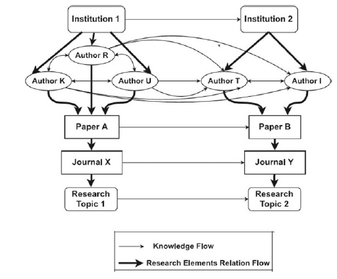
Knowledge Flow Through Citation
Knowledge flows through verbal communications, books, documents, video, audio, and images, which plays a powerful role in research community in promoting the formulation of new knowledge.
In engineering research, knowledge flow is primarily in the form of books, thesis, articles, patents, and reports.
Citing a source is important for transmission of knowledge from previous work to an innovation.
Production of knowledge can be related to the citation network.
Knowledge flow happens between co-authors during research collaboration, among other researchers through their paper citation network, and also between institutions, departments, research fields or topics, and elements of research.

Slide 40
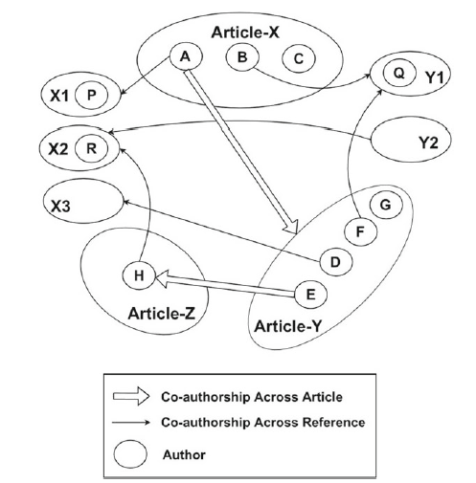
Citing Datasets

Slide 41
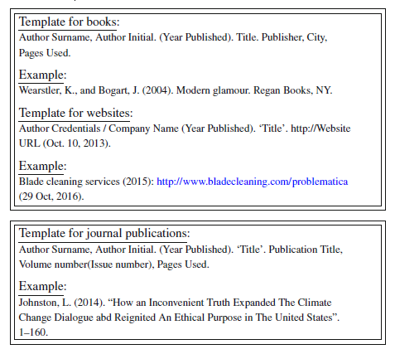
Styles for Citations
ASCE style (American Society of Civil Engineers)
Reference list: this part is to be placed in the bibliography or references at the end of the article or report. A template with example for the same is given below:

Slide 42
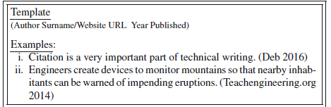

Styles for Citations
In-text citation for journals or books: The following part is to be placed right after the reference to the source of the citation assignment:
2. IEEE style (Institute of Electrical and Electronics Engineers)3 IEEE style is
standard for all IEEE journals and magazines, and is frequently used for papers
and articles in the fields of electrical engineering and computer science.
3. ASME style (The Association of Mechanical Engineers)4

Slide 43
Acknowledgments and Attributions
Acknowledgment section is a place to provide a brief appreciation of the contribution of someone or an organization or funding body to the present work.
If no particular guideline is available for the intended publication, then it can be introduced at the end of the text or as a footnote.
Acknowledgment is a common practice to recognize persons or agencies for being responsible in some form or other for completion of a publishable research outcome.
Acknowledgment displays a relationship among people, agencies, institutions, and research.

Slide 44
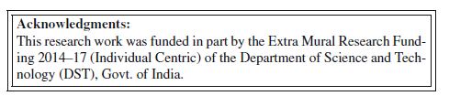
What Should Be Acknowledged?
Every author should know that what should/should not be acknowledged.
Author should acknowledge quotation, ideas, facts, paraphrasing, funding organization, oral discussion or support, laboratory, and computer work.

Slide 45
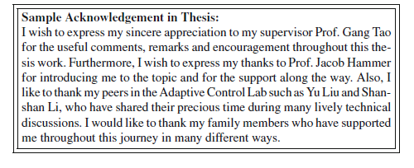
Acknowledgments in Books/Dissertations
A page of acknowledgments is usually included at the beginning of a thesis/dissertation immediately following the table of contents.

Slide 46
Dedication or Acknowledgments?
Dedication is almost never used in a journal paper, an article in a conference proceedings, or a patent, and it is used exclusively in larger documents like books, thesis, or dissertations.
While acknowledgments are reserved for those who helped out with the book in some way or another (editing, moral support, etc.), a dedication is to whomever the author would like it to be dedicated to, whether it is the author’s parents, Spouse, Children, the best friend, the pet dog, or Almighty God.

Slide 47

"Research is creating new knowledge."

